Slide 1
Course project phase 1
Ryan Clark Spring 2023
BAN 502 Predictive Analytics

Slide 2
Problem
Conduct exploratory analysis to determine which variables in the Super Soaker product testing dataset are strong predictors of the “failure” variable.

Slide 3
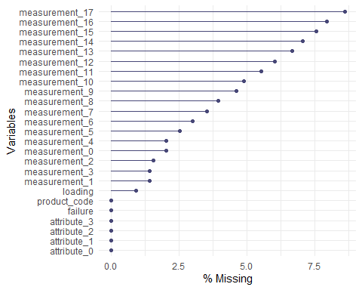
Super soaker product testing Dataset
Name failurefull
Number of observations 26,570
Number of variables 25
There are 26,570 observations across 25 variables in the dataset. However, there are many missing values. For example, measurements 11 through 17 have > 5% missingness. However, all variables are 90%+ complete and should be retained for analysis.

Slide 4
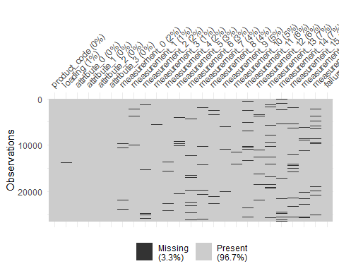
Where do the missing values occur?
This chart shows the location of missing values across the dataset. The missingness appears to be random with no discernible patterns. Deleting entire observations or variables with any missing values would eliminate a substantial portion of data when in fact 96.7% is present. For this reason, I pursue imputation prior to analysis to fill in the missing values with reasonable estimates to preserve valuable data. However, I am going to delete observations where the loading variable is missing because it seems key to the product’s effectiveness.

Slide 5
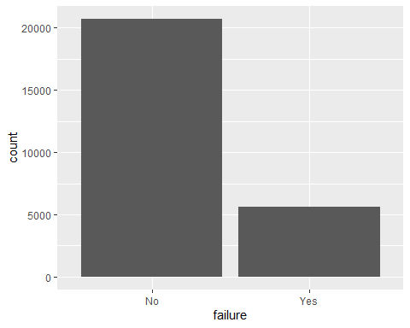
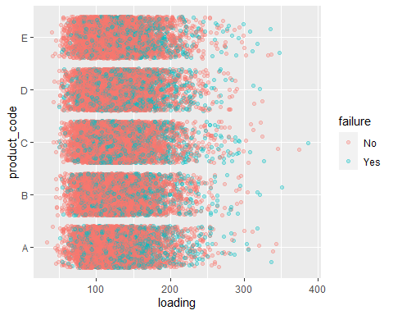
Exploratory analysis
79%
21%
Product failure occurred in 5,649 of the observations, or 21% of the time. Failure appears to increase across all of the product codes as loading values are increased.

Slide 6
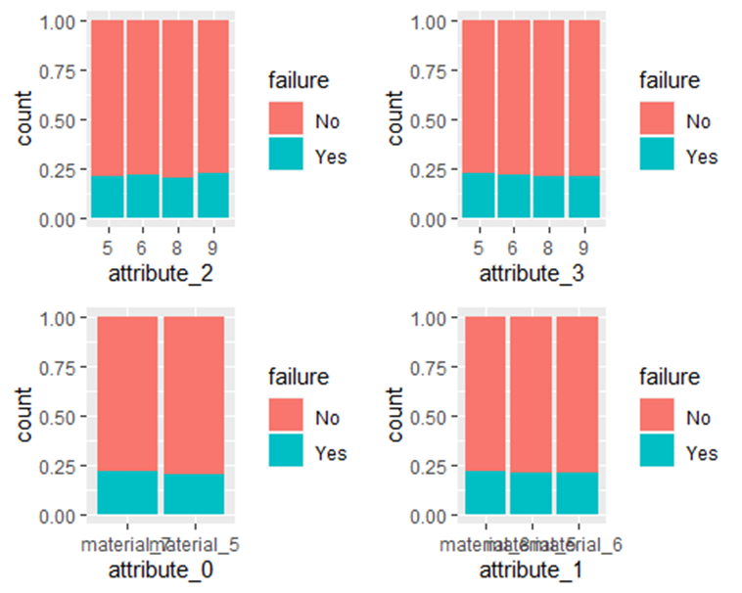
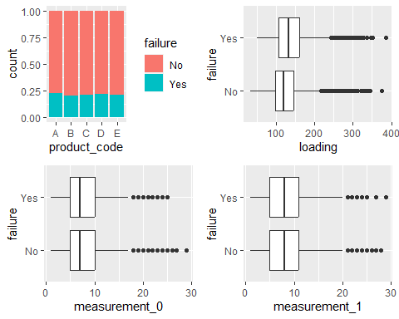
Product failure is our response variable. For this analysis, I plot each variable against failure to see if there is a significant difference between values for products that failed and those that did not fail. For the categorical variables, we can observe differences in the proportion of failure by looking at color coded bar charts. There is some variation in the proportion of failure across the attributes and product codes. Of these, product code, attribute_2, and attribute_0 appear to be the strongest predictors of failure.
Similarly, for numeric variables, boxplots show the distribution of observed values against failure. Here, we are looking for any discernable difference in the mean value (vertical line) and/or dispersion (box shape) for products that failed/did not fail. On this page, we see a higher mean loading value for products that fail.

Slide 7
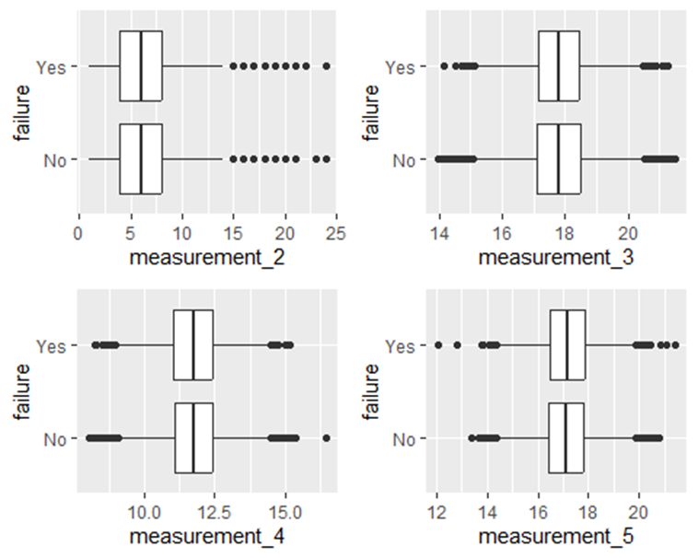
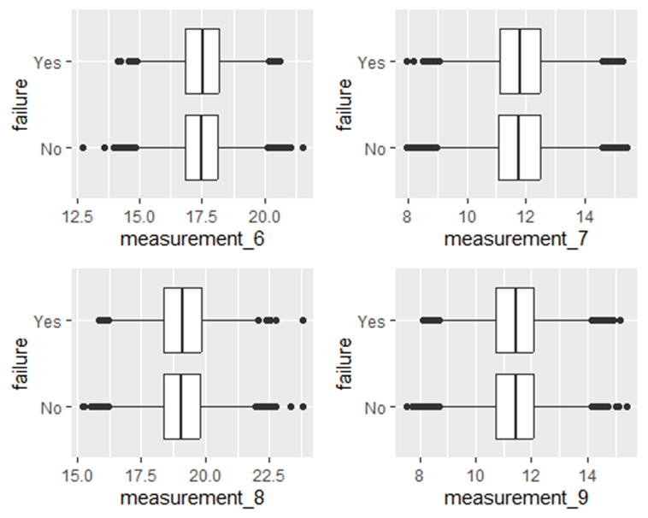
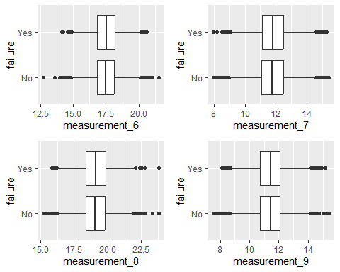
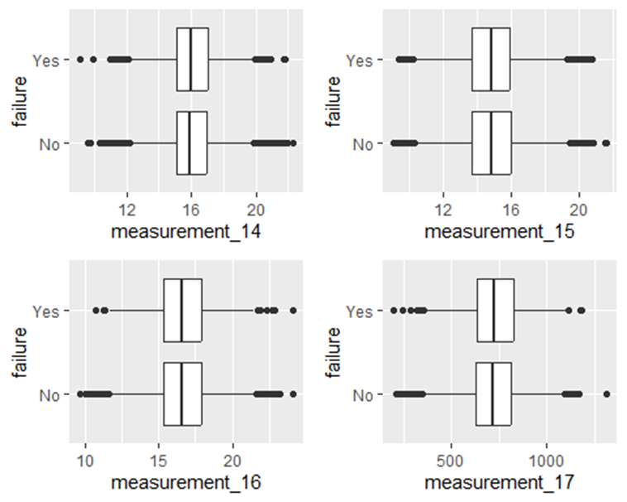
For the most part, there’s nothing to see in the boxplots for the various measurements. By and large, the mean and dispersion of values are similar for products regardless of failure status. There may be a slight different in mean values for measurements 5, 8 and 17. However, I wouldn’t consider these to be “strong” predictors of failure.

Slide 8
Summary: Predictors of failure
Product code
Attribute 2
Attribute 0
Loading

